Slide 1
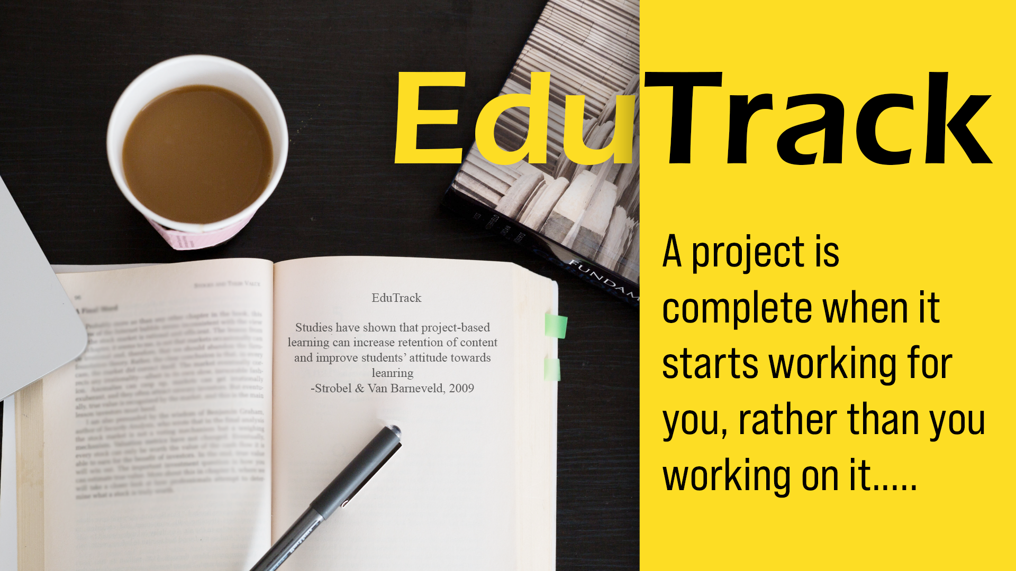

Slide 2

Problem Statement : Project Co-Ordination
In final year of college, students need to build a good project with a faculty. For the college it is difficult to manage, view & approve a project. Build a portal where teachers can first approve the project that students want to build and then track all the progress till the project is submitted.

Slide 3
Solution
Platform : Desktop App
Through this platform colleges can administer minor & major projects
Students can easily make projects with the help of faculties

Slide 4
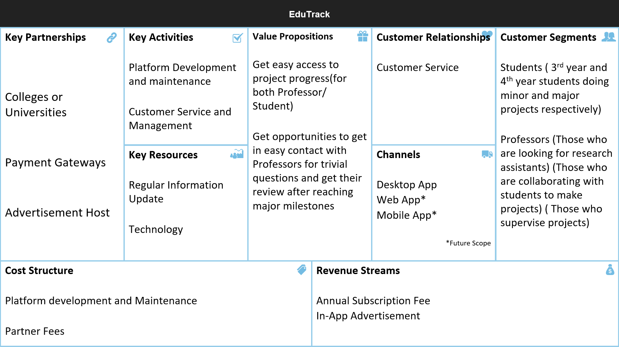
Business Model Canvas

Slide 5

How it works
On EduTrack Students and Teachers can Login using their College email ids
Students can group themselves to make a project
Project Topics selected will be sent to a waitlist which will be approved or rejected by the respective Department Heads
Students will have to update their progress at least once a week

Slide 6
How it works
Respective Professors will have to track the students’ projects
They will get a prompt when the projects get completed 30%, 60% and 100%
Professors will have to give their reviews for the same
Students can contact the professors through EduTrack to ask trivial questions

Slide 7
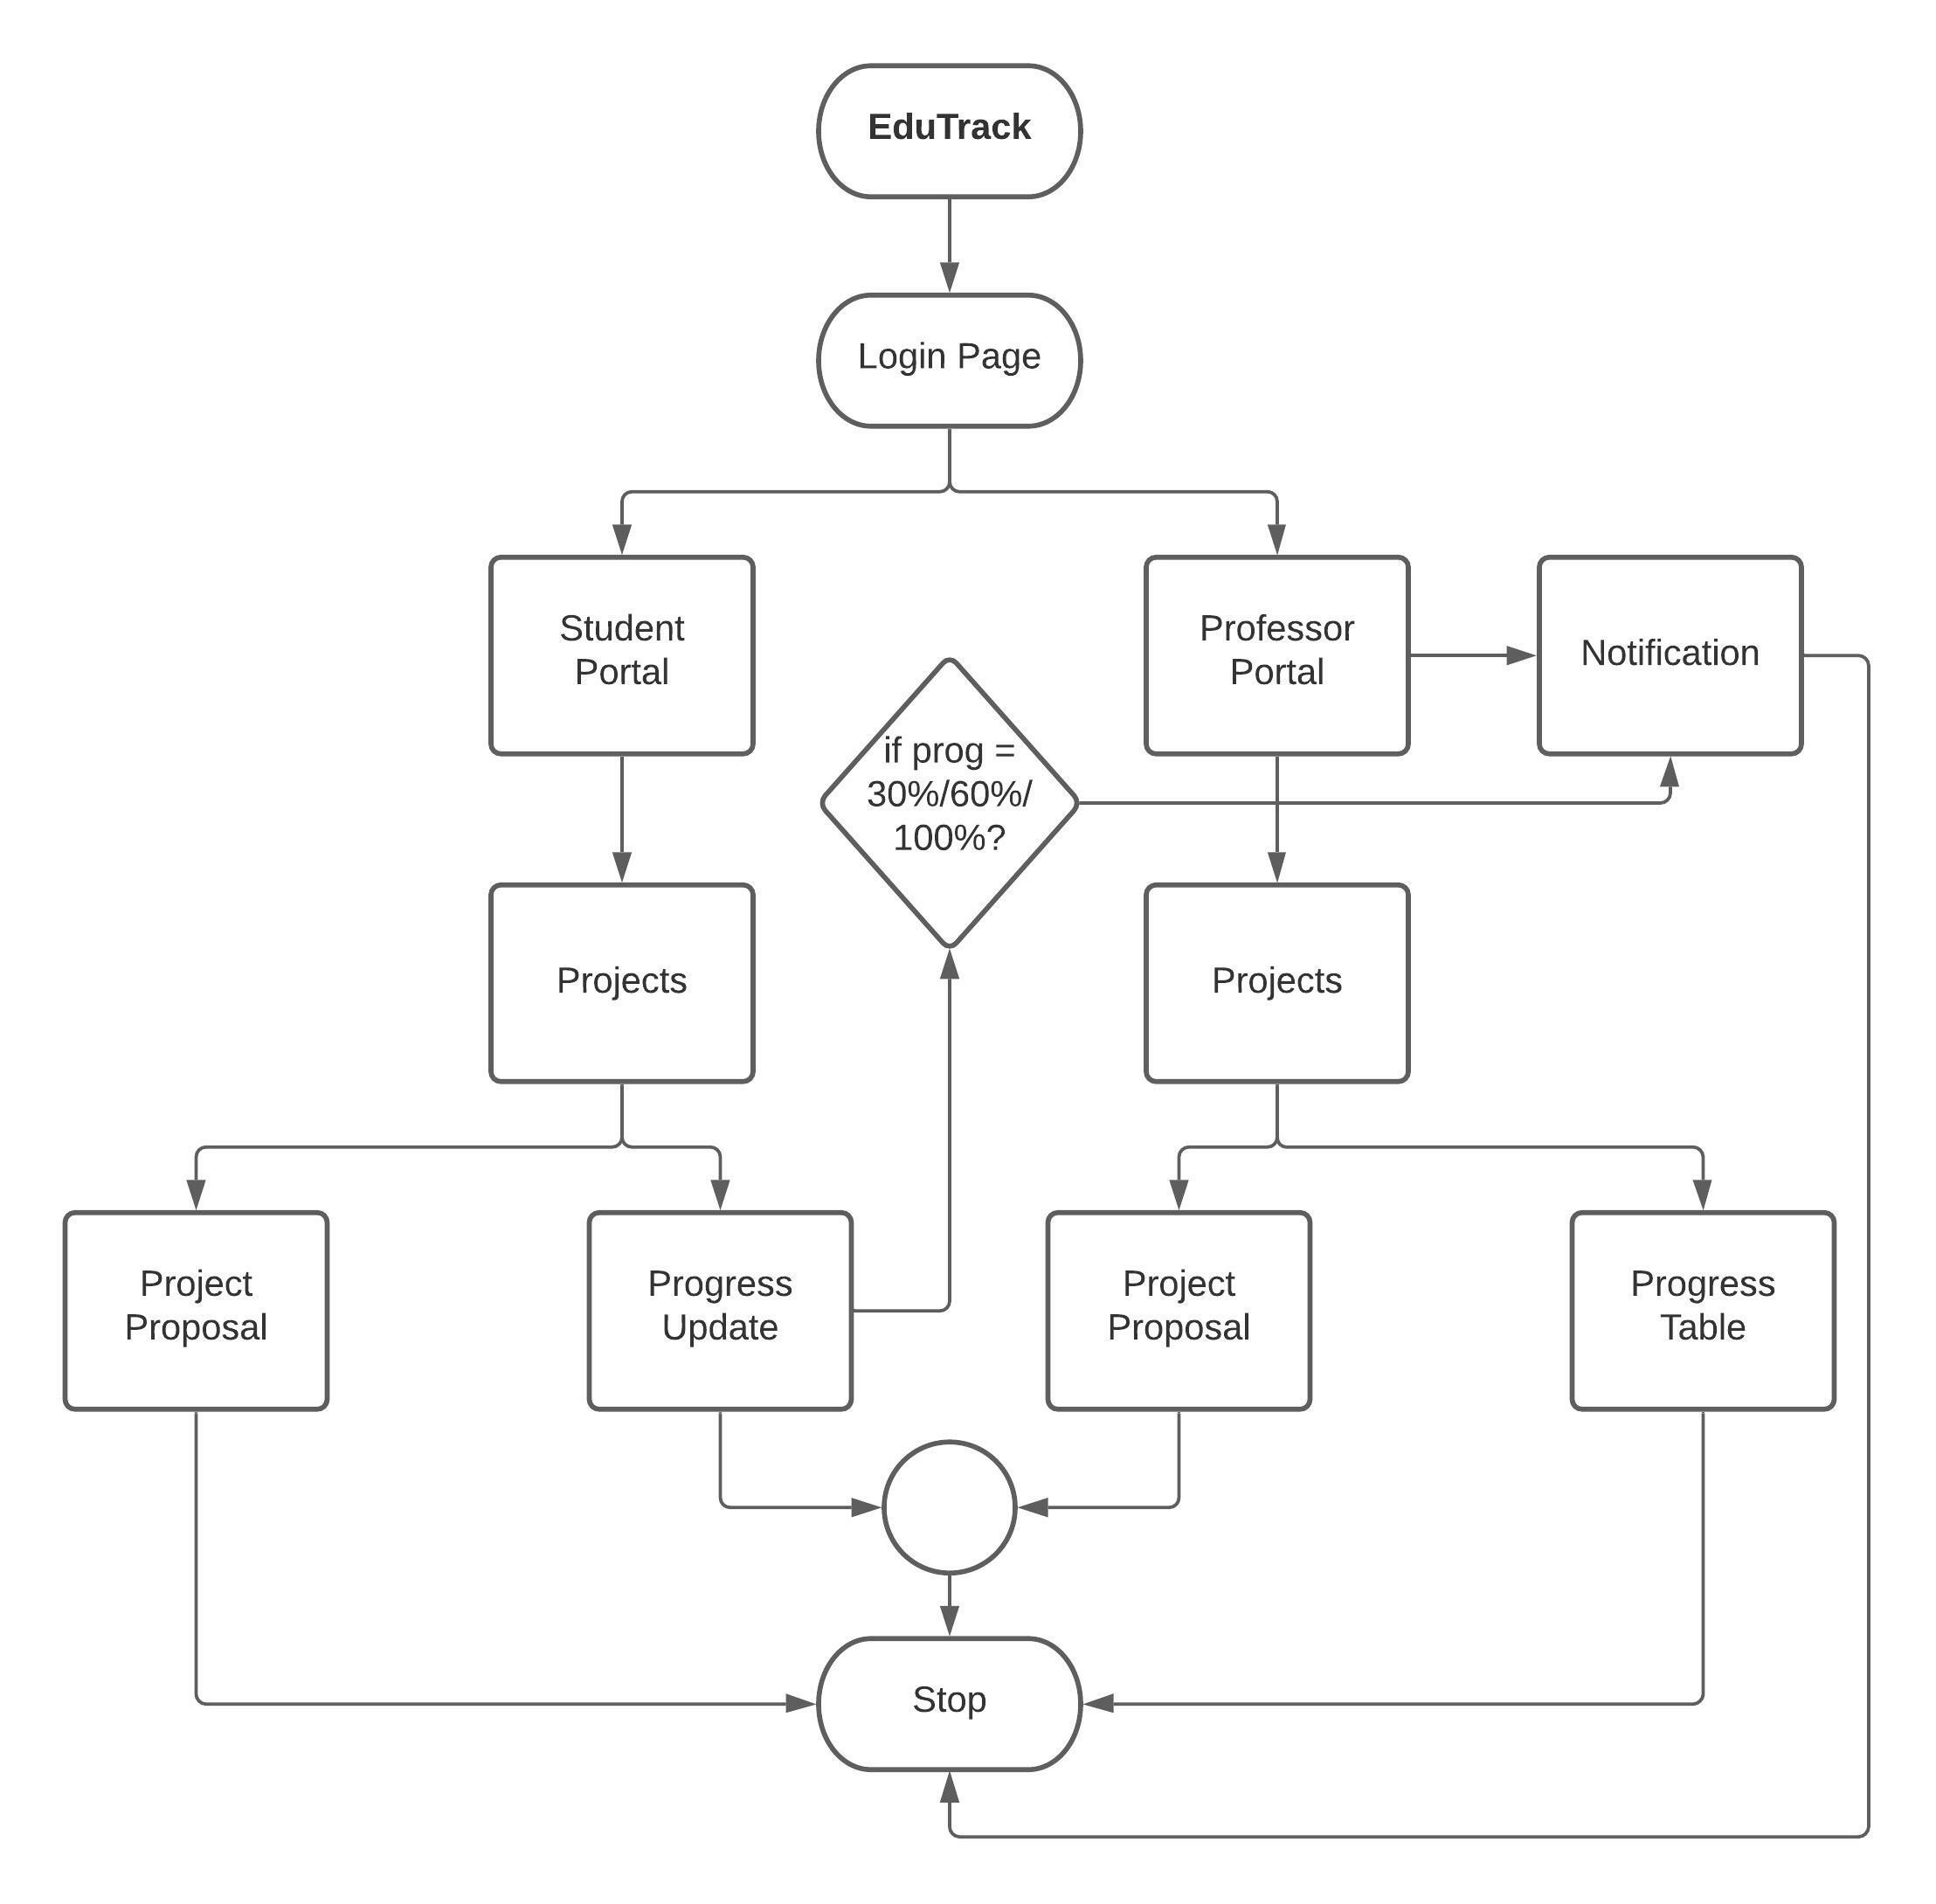
Flowchart

Slide 8
Future Scope
Students with a startup can recruit students for the same
Internhsip opportunities for 3rd year students
Queuing for Atal Incubation Centre
Opportunity for being Research Assistant

Slide 9

Target Market
Universities or Colleges facing problems managing Minor and Major Projects

Slide 10
Market Scope
Website
App (Android and iOS)
Desktop Application

Slide 11
Business model
Service Fee paid by the particular college to use EduTrack
Ads of the particular College Startups with minimum price (only one per screen)
Donations

Slide 12
Competitors
So basically EduTrack has only one competitor (most probably (: ) which is called OpenProject.org
“Link faculties, students and project teams in a central web-based project management system for universities - for project work or administration.”

Slide 13
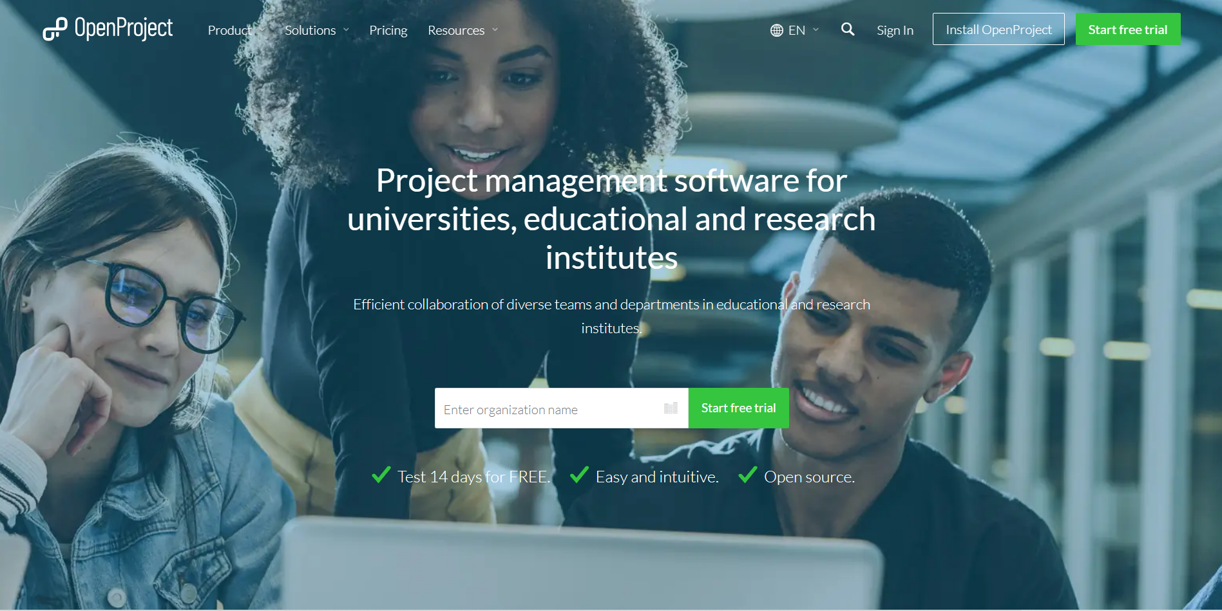

Slide 14
Advantages over the Competitors
Our advantage is basically that we focus on Teacher or College and Student Collaboration while our competitor covers all aspects of projects and not just college ones
EduTrack is basically clutter free
It is also very cost-effective as the student does not really have to pay any fee and the small fee that we collect is Paid by the College
The Ads showed on the page is also of a startup of the particular college of the student or professor

Slide 15
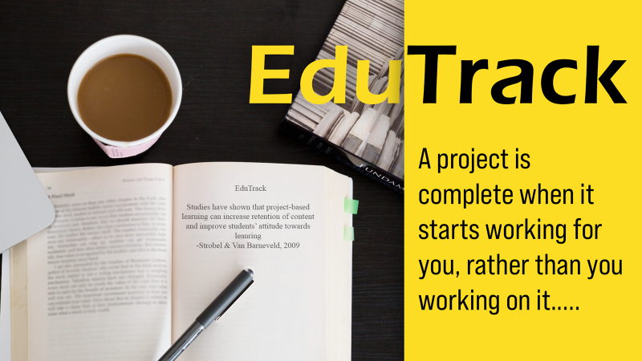
Thank You

